Slide 1
Chapter 2 - Computer Security Threats and Attacks

Slide 2
2.1 Threats and Attacks
  A computer security threat is a potential violation of security; it is any person, act, or object that poses a danger to computer security/privacy
  The violation need not actually occur for there to be a threat
  The fact that the violation might occur means that those actions that could cause it to occur must be guarded against (or prepared for)
  Those actions are called attacks
  Those who execute such actions, or cause them to be executed, are called attackers
  The computer world is full of threats; viruses, worms, crackers, etc.
  And so is the real world; thieves, pick-pockets, burglars, murderers, drunk drivers, …
  Note: the terms threat and attack are commonly used to mean more or less the same thing

Slide 3
Types of threats
  Disclosure: unauthorized access to information (also called Snooping or Interception)
    e.g., Snooping: unauthorized interception of information
  Deception: acceptance of false data (modification, spoofing, repudiation of origin, denial of receipt)
    e.g., Modification: unauthorized change of information
  Disruption: interruption or prevention of correct operation
    Disrupting access to or use of information or an information system; disruption of an entire network, either by disabling the network or by overloading it with messages so as to degrade performance
  Usurpation: unauthorized control of some part of a system
    e.g., Identity theft; Denial of service

Slide 4
What do you do in real life?
  You learn about the threats
    What are the threats
    How can these threats affect you
    What is the risk for you to be attacked by these threats
    How you can protect yourself from these risks
    How much does the protection cost
    What can you do to limit the damage in case you are attacked
    How can you recover in case you are attacked
  Then, you protect yourself in order to limit the risk but to continue to live your life
You need to do exactly the same thing with computers!

Slide 5
Types of attacks: One way of categorizing attacks is as passive and active
  Passive Attacks
    A passive attack attempts to learn or make use of information from the system but does not affect system resources
    There are two types of passive attacks: release of message contents (or sniffing) and traffic analysis
    Release of message contents: A telephone conversation, an electronic mail message, and a transferred file may contain sensitive or confidential information; we would like to prevent an opponent from learning the contents of these transmissions
    It is also called interception: An attack on confidentiality
Source
Destination
Attack
Normal flow of information
Interception

Slide 6
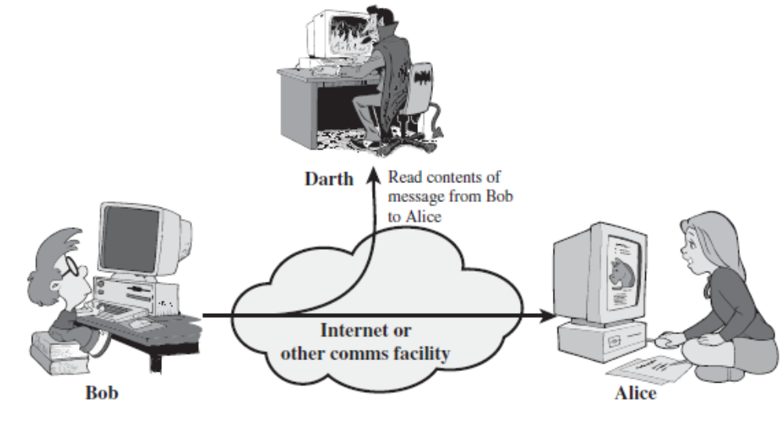
Trudy
  Friends and Enemies: Alice, Bob, Trudy
    Well-known in the network security world
    Alice and Bob (lovers!) want to communicate “securely”
    Trudy (the intruder) may intercept, delete, or add messages

Slide 7
Alice and Bob could be
  two routers that want to exchange router tables securely
  a client and a server that want to establish a secure transport connection
  two e-mail applications or persons that want to exchange secure e-mail
  a person transferring his credit card number securely to a web server
  a person interacting with his/her bank online
  etc.

Slide 8
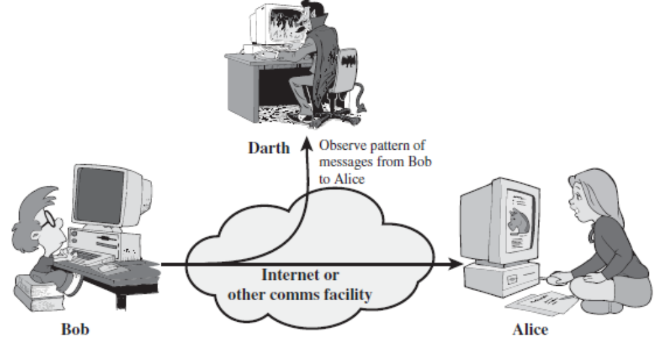
Traffic analysis: to determine the location and identity of communicating hosts and to observe the frequency and length of messages being exchanged (even if the message is encrypted). This information might be useful in guessing the nature of the communication that was taking place
Trudy

Slide 9
Packet sniffer: a program that records a copy of every packet that flies by including such sensitive information as passwords, trade secrets, private personal messages, etc.
Sniffed packets can then be analysed offline for sensitive information
Broadcast media (Ethernet LANs and wireless LANs) are the most vulnerable
Sniffers can also be planted at an institution’s router and copy all packets going to/from the organization
Packet sniffer software are freely available and some are commercial; e.g., Wireshark is a (free) packet sniffer; others include etherfind, windump, tcpdump, and network management utilities such as SnifferPro (they usually require administrator privilege)
Note: sniffer programs are two-edged!
  attacker uses them for eavesdropping
  defender uses them for defense purposes: intrusion detection

Slide 10
It is usually difficult to detect passive attacks because they do not involve any alteration of the data
Snooping
  Snooping is a passive attack; it is unauthorized interception of information, e.g., passive wiretapping (not necessarily physical wiring)
  It is a form of disclosure
Active Attacks
  An active attack attempts to alter system resources or affect their operation
    The transmitted data is fully controlled by the intruder
    The attacker can modify, delete or view any data
  This is quite possible in TCP/IP since the frames and packets are not protected in terms of authenticity and integrity (more later in Chapter 4 - Network Security Concepts and Mechanisms)

Slide 11
Categories of Active Attacks
  1. Spoofing or Masquerading: also called fabrication: An attack on authenticity
  2. Modification or Alteration: An attack on integrity
  3. Delay: Could be classified as an attack on availability
  4. Denial of Service (DOS) or degrading of service or Interruption: An attack on availability
Source
Destination
Attack
Normal flow of information
Modification
Fabrication
Interruption

Slide 12


1. Spoofing or Masquerading
  A situation in which one person or program successfully imitates another (impersonation) by falsifying data and thereby gaining an illegitimate advantage
  It lures a victim into believing that the entity with which it is communicating is a different entity. For example, if a user tries to log into a computer across the Internet but instead reaches another computer that claims to be the desired one
Alice
Trudy
src: Bob dest: Alice payload
Message from Trudy that appears to be from Bob
Bob

Slide 13
It is a form of both deception and usurpation
Note: Delegation is a form of Masquerading that occurs when one entity authorizes a second entity to perform functions on its behalf and is not a violation of security
Common examples of spoofing
  IP spoofing: the ability to inject packets to the Internet with a false source address; then the receiver performs some commands embedded in the packet’s payload (say modifies its forwarding table)
  DNS spoofing
    Changing the DNS information so that it directs to a wrong machine
  URL spoofing/Webpage phishing
    A legitimate web page such as a bank's site is reproduced in "look and feel" on another server under the control of the attacker (More later in Section 2.3)
  E-mail address spoofing

Slide 14
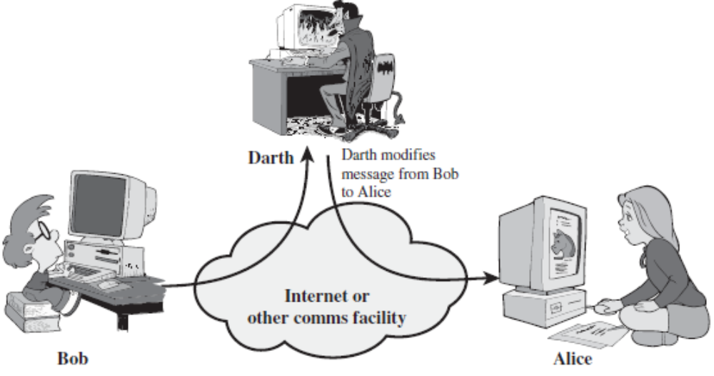
2. Modification or Alteration
  An unauthorized change of information
  Covers three classes of threats
    Deception: if some entity relies on the modified data to determine which action to take
    Disruption and usurpation: if the modified data controls the operation of the system
  Active wiretapping is a form of modification in which data moving across a network is altered
Trudy
Trudy modifies message from Bob to Alice

Slide 15

  An example is the man-in-the-middle attack, in which an intruder reads messages from the sender and sends (possibly modified) versions to the recipient
Alice
Trudy
src: Bob dest: Alice user Bob; password: foo
Bob
3. Delay
  A temporary inhibition of a service
  Is a form of usurpation
  If an attacker can force the delivery to take more time for a message through manipulation of system control structures, such as network components or server components

Slide 16
4. Denial of Service (DOS) or degrading of service attack
  Attackers make resources (server, bandwidth) unavailable to legitimate traffic by overwhelming with bogus traffic
  It is blocking access (prevention) of legitimate users to a service/system
  Is a form of usurpation
  The denial may occur at the source (by preventing the server from obtaining the resources needed to perform its function), at the destination (by blocking the communications from the server), or along the intermediate path (by discarding messages from either the client or the server, or both)

Slide 17
Any device has operational limits (workload)
A workload for a computer system may be defined by the number of simultaneous users, the size of files, the speed of data transmission, or the amount of data stored
If the requests exceed any of those limits, the excess load will stop the system from responding. For example, if one can flood a web server with more requests than it can process, it will be overloaded and will no longer be able to respond to further requests
Distributed DoS: attacking a target (victim) by many computers called Zombies (or Slaves or bots) which are members of a botnet simultaneously with large number of packets since just one machine is not going to adversely affect the target (or can be easily traced)
  How many machines to use to deny e depends on the capacity of the targetservic

Slide 18
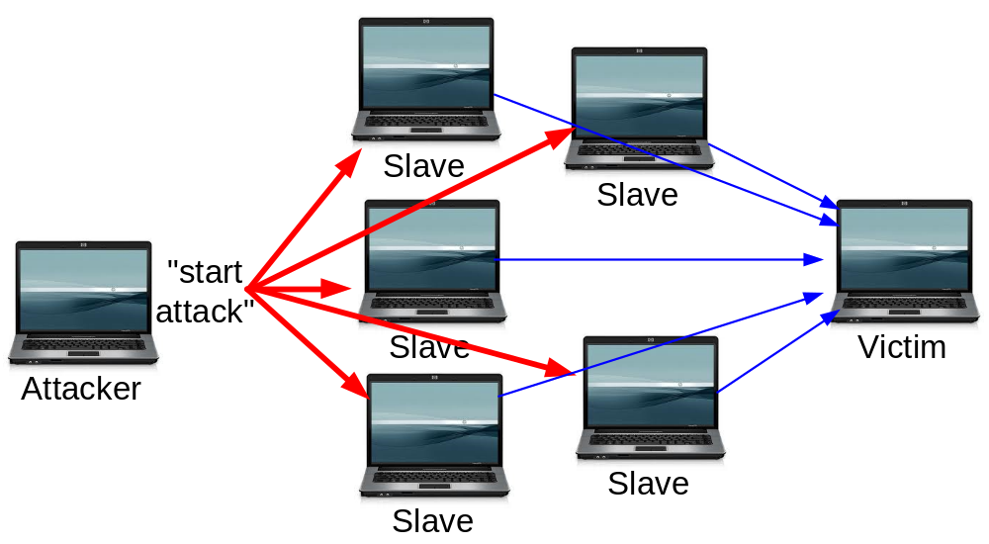
botnet
Examples
  E-mail bombing: flooding someone's mail store
  Smurf attack: is a DDoS attack in which large numbers of ICMP packets with the intended victim's spoofed source IP are broadcast to a computer network using an IP broadcast address. The recipients will respond to the victim flooding it
  There had been reports of incidences of DDoS attacks against major sites such as Amazon, Yahoo, CNN and eBay

Slide 19



Common DDOS tools used
  TFN (Tribal Flood Network), TFN2K, and Stacheldraht (means barbed wire in German)
-l 65000 buffer size
-t continue until stopped (Ctrl-C)
Simple illustration of DDoS attack (from Easttom)
C:\>Ping 169.10.10.3 -l 65000 -t
Web Server X 169.10.10.3
Ping
Ping
Ping
Legitimate User
Ping

Slide 20
More on Botnets
  A botnet is a collection of machines that have been compromised (a.k.a zombies) and are being controlled remotely by one or more individuals
  It is a huge distributed network of infected computers that are commanded through command-and-control servers (or C2 servers)
  Bot software is usually delivered as a payload within a virus or worm
  It travels from machine to machine creating an army of zombies
  The zombies log on to a C2 server and wait for orders
  A user has no idea that his machine is a zombie, but the machine may suddenly become slower

Slide 21
  Once a botnet has been established, it can be leased to send spam, to enable phishing scams geared toward identity theft, to perform DDoS attacks, etc.
  e.g., in September 2005, police in the Netherlands uncovered a botnet consisting of 1.5 million zombies

Slide 22
Types of Threats/Attacks – another way of categorizing attacks
  Physical Attack
    Stealing, breaking or damaging of computing devices
    Covered in Chapter 1
  Denial of Service (DoS) Attack
    Already Covered
  Malware Attack
    A generic term for software that has malicious purpose
  Hacking (Intrusion) Attack
    Hacking: is any attempt to intrude or gain unauthorized access to a system either via some operating system flaw or other means. The purpose may or may not be malicious

Slide 23
  There are three groups of hackers
    A white hat hacker, upon finding some flaw in a system, will report the flaw to the vendor of that system (probably anonymously) and explain exactly what the flaw is and how it was exploited. White hat hackers, also called Sneakers, are often hired specifically by companies to do penetration tests. The European Council even has a certification test for white hat hackers, the Certified Ethical Hacker test
    A black hat hacker is the person normally depicted in the media. Once s/he gains access to a system, her/his goal is to cause some type of harm. S/he might steal data, erase files, etc. Black hat hackers are sometimes referred to as crackers. Cracking is hacking conducted for malicious purposes
      There is always an ongoing arms race between Black Hats and White Hats
    A gray hat hacker is normally a law-abiding citizen, but in some cases will venture into illegal activities

Slide 24
Script Kiddies
  A hacker is an expert in a given system; as with any profession it includes its share of frauds
  So what is the term for someone who calls himself or herself a hacker but lacks the expertise?
  The most common term for this sort of person is script kiddy
  The name comes from the fact that the Internet is full of utilities and scripts that one can download to perform some hacking tasks
Phreaking
  One specialty type of hacking involves breaking into telephone systems
  It is the action of using mischievous and mostly illegal ways in order not to pay for some sort of telecommunications bill, order, transfer, or other service
  Phreaking requires a significant knowledge of telecommunications

Slide 25
2.2 Malware Attack
  Examples are
    Viruses
    Worms
    Trojan horses
    Spywares and Adwares
    Logic bombs
    Bacteria or Rabbit
A Nonvirus Virus or a Hoax
Scam, Identity theft, and Phishing
Rootkit, Malicious Web-Based Code, e-payment frauds, and Spam
  Virus
    “A program fragment that replicates and hides itself inside other programs usually without your knowledge.”
    Similar to a biological virus: replicates and spreads by its own
    Damage varies on what the writer thinks

Slide 26
Worm
  An independent program that reproduces by copying itself from one computer to another (usually through networks)
  It can do as much harm as a virus
  It often creates denial of service
  Note: the classification of a malware as a virus or a worm is not universally agreed upon
Trojan Horse
  Ancient Greek tale of the city of Troy and the wooden horse which was full of soldiers
  A Trojan horse, appearing to be benign software, may secretly download a virus or some other type of malware on to your computers
  The program does what the user expects but it does more, unnoticed by the user

Slide 27
Spyware
  “A software that literally spies on what you do on your computer”
  Examples
    Cookies: Any data that the cookie saves can be retrieved by any website, so your entire Internet browsing history can be tracked
    Key Loggers: a computer program that records every keystroke made by a computer user, in order to gain access to passwords and other confidential information
  Legal Uses of Spyware
    Employers may use spyware as a means of monitoring employee use of company technology
    Parents may use this type of software on their home computer to monitor the activities of their children on the Internet to protect their children from online predators

Slide 28
  Adware: a piece of spyware that downloads to your PC when you visit certain websites. It is benign in that it causes no direct harm to a system or files, nor does it gather sensitive information from a PC. However, it is incredibly annoying as it saturates a machine with unwanted ads
  For a list of known spyware products on the Internet and for information about methods one can use to remove them, visit the Counterexploitation website at www.cexx.org
  The Spyware Guide website (www.spywareguide.com) also lists spyware that you can get from the Internet
Logic bomb
  Software that lays dormant until some specific condition is met; that condition is usually a date and time; when the condition is met, the software does some malicious act such as deleting files, altering system configuration, or perhaps releasing a virus

Slide 29
A Nonvirus Virus or a Hoax
  Another new type of virus
  Rather than actually writing a virus, a perpetrator sends an e-mail to every address he has. The e-mail claims to be from some well-known antivirus center and warns of a new virus that is circulating. The e-mail instructs people to delete some file from their computer to get rid of the virus. The file, however, is not really a virus but part of a computer’s system
  Some people could even e-mail their friends and colleagues to warn them to delete such a file from their machines
Bacteria or Rabbit
  A bacterium or a rabbit is a program that absorbs all of some class of resource

Slide 30
  The following piece of code could exhaust disk space
      while true do
      {
        mkdir x
        chdir x
      }
Other Forms of Malware
  More on scam, identity theft, and phishing in Section 2.3
  Read about the following: Rootkit, Malicious Web-Based Code, e-payment frauds, and Spam

Slide 31
Most software based attacks are viruses/worms: How do they work? Or what are the major steps?
  1. Infection (Mechanisms)
    First, the virus should search for and detect objects to infect
    Installation into the infectable object
      Writing on the boot sector (but becoming outdated)
      Scan the computer for connections to a network, then copy itself to other machines on the network to which the infected computer has access
      Read your email address book and email itself to everyone in your address book
      Add some code to executable programs
      Add some code to initialization/auto-executable programs
      Write a macro in a word file, etc.
    The term virulent is a measure of how rapidly the infection spreads and how easily it infects new targets

Slide 32
  2. Trigger Mechanisms
    Date
    Number of infections
    First use
  3. Effects (or Payload): It can be anything
    In general, once a virus is on a system, it can do anything that any legitimate program can do
      Displaying a message
      Deleting files
      Formatting the hard disk
      Overloading the processor/memory
      Changing system settings
      etc.

Slide 33
Method: design of a virus
  Detection module: detects programs that are already infected
  Infection module: copies the virus code into non-infected programs
  Damage module: contains the malware proper
  Conditions module: makes the actions mentioned dependent on certain condition
  Camouflage module: tries to avoid detection by anti-virus software
      Nowadays camouflaging by viruses is highly sophisticated

Slide 34
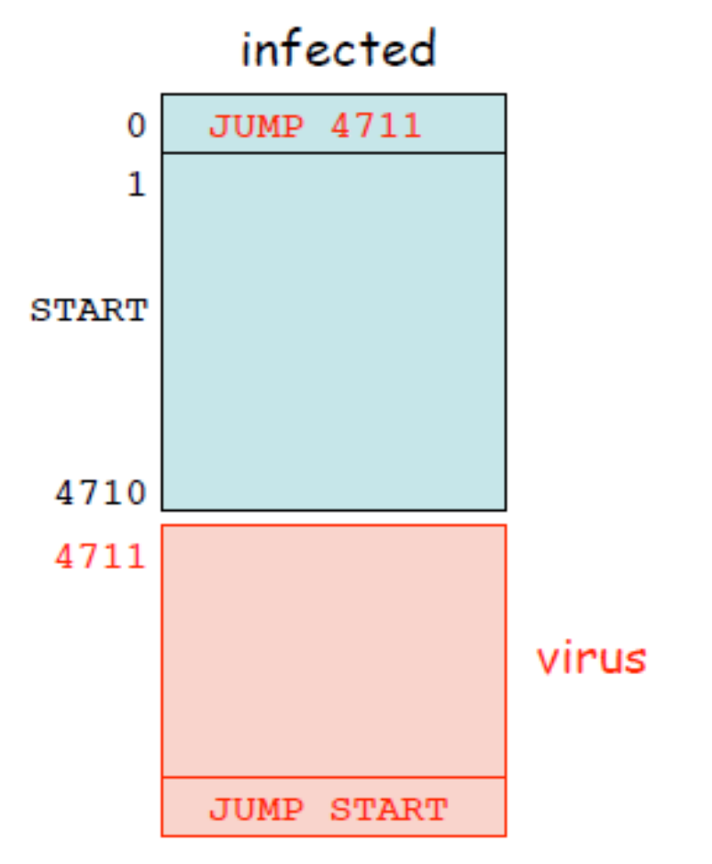
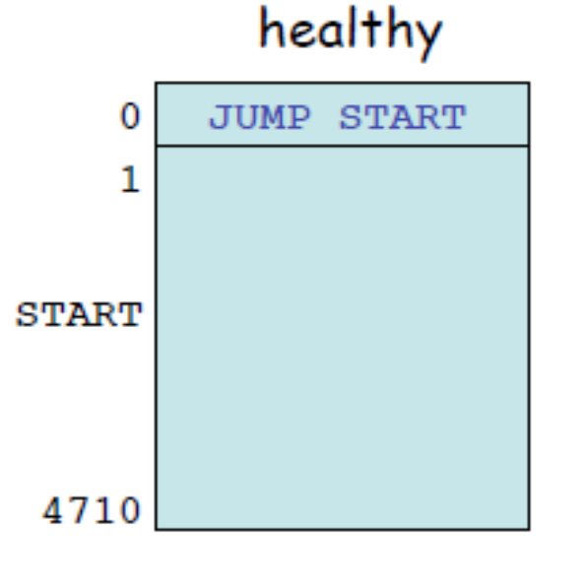
  Typical binary code layout (simplified)

Slide 35
Who Writes Viruses
  It is believed that most virus authors are young men in their teens or early twenties who have a great deal of technical knowledge and have decided for various reasons to use it for destructive purposes
  People who just want to test the system; they are delighted in finding a way to insert their code into places where others might not find it
  To “punish” users for some perceived breach; for example, to punish users of illegal copies of software (software pirates)
  Troublemakers - or may be just troubled individuals - who want to create havoc
  Revenge: Sometimes viruses, trojan horses or logic bombs are written by disgruntled employees or others who want to get back at someone

Slide 36
  As a Challenge: Some virus writers do it just to see if they can go away with it; as virus detection software gets smarter, virus writers have to employ new tricks to have their "products" evade notice
  Education: Writing viruses, especially ones smart enough to avoid detection, requires a great deal of technical know-how; some people take up virus writing to teach themselves how to program at a low-level within the PC; it is ironic, but experienced virus writers are among the most technically skilled programmers in the world
  etc.
Many viruses specifically target antivirus software programs
Hence, antivirus programs modify themselves to protect against such attacks
As some say it, it is a digital war zone and our hard disk is the battleground

Slide 37
Anti-Virus
  There are
    Generic solutions: e.g., Integrity checking
    Virus specific solutions: e.g., Looking for known viruses
  Three categories
    Scanners: to look for a signature (or pattern) that matches a known virus
    Activity monitors: If the program behaves in a way consistent with virus activity
    Change detection software
  Functions of anti-viruses
    Identification of known viruses
    Detection of suspected viruses
    Blocking of possible viruses
    Disinfection of infected objects
    Deletion and overwriting of infected objects

Slide 38
Tips for Avoiding Viruses and Spyware
  Use a virus scanner such as McAfee, Norton, Kaspersky, AVG, etc.
  If you are not sure about an e-mail attachment, do not open it
  Do not believe “security alerts” that are sent to you. For instance, Microsoft does not send out alerts in this manner
  Check antivirus websites regularly; You can read more about any virus, past or current, at the following websites:
    www.f-secure.com/virus-info/virus-news/
    www.cert.org/nav/index_red.html
    http://securityresponse.symantec.com/
    http://vil.nai.com/vil/

Slide 39
2.3 Internet Fraud
Reasons for the popularity of Internet fraud
  Committing an Internet fraud does not require the technical expertise that hacking and virus creation require
  There are a great number of people engaging in various forms of online commerce, and this large amount of business creates a great many opportunities for fraud
Scam
  Sending out an email that suggests that you can make an outrageous sum of money with a very minimal investment (e.g., the Nigerian fraud)
Identity theft
  For one person to take on the identity of another
  Usually attempted to make purchases
  But identity theft can be done for other reasons, such as obtaining credit cards in the victim’s name, or even driver’s licenses, e-payment frauds, etc.

Slide 40
Phishing
  One of the more common ways to accomplish identity theft
  It is the process of trying to induce the target to provide you with personal information
  e.g., the attacker sends out an email claiming to be from a bank, and telling recipients that there is a problem with their bank account. The email then directs them to click on a link to the bank website where they can login and verify their account. However, the link really goes to a fake website set up by the attacker. When the target goes to that website and enters his information, he will have just given his username and password to the attacker
Read about the following: Investment Advice, Auction Frauds (Shill Bidding, Bid Shielding, Bid Siphoning), Cyber Stalking

Slide 41
  Assignment
    Read about DES (Data Encryption Standard) and understand the algorithm so that our next classes become smooth
    The best source of information is
    William Stallings, Cryptography and Network Security Principles and Practice, Prentice Hall, 5th edition, 2011. Pages 77-85

